Slide 1
Outbound

Slide 2
WM Module Overview
INBOUND
Receiving
Palletization
Inventory Management
Appointment Scheduling
Putaway
Cycle Count
Physical Inventory
Value Added Services
TASK MANAGEMENT
TRANSPORTATION EXECUTION
OUTBOUND
Carrier Selection/Routing
BOL/Manifest
Wave
Management
Picking
Value Added Services
Replenishment
Packing
Consolidation
Staging
Loading
Load Planning
& Dock Door
Management
Freight
Charges
PARCEL SHIPPING
Notes:
WM MODULE OVERVIEW
Refer to Modular Functional Overview Appendix for a description of the functionality contained in each module. This logical breakdown of options makes it easier to learn ‘where to look for what' in WM. WM has the powerful advantage of being modular in nature. This allows the Distribution Center to implement only those portions of WM most crucial to its success. The modular structure also makes WM affordable and easy to implement using a 'phased implementation‘ approach.
INVENTORY MANAGEMENT SYSTEM ("IMS")
The Inventory Management System Module is also referred to as the Inbound module. It is used to receive and track inventory at a greater level of detail than a host order processing system. This module includes receiving, putaway, stock locator, inventory control, pull processing, physical and cycle counting, and work order management functions.

Slide 3
Outbound - Modules
Waves
Inventory Allocation and Replenishment
Cubing
Picking
Order Consolidation
Ship Confirmation
Transportation

Slide 4




Outbound Interfaces
Purpose
To fulfill orders
To make money

Slide 5
Outbound Interface Summary
Distribution Order (download)
Host
(ERP System)
WM
Ship Confirm (upload)

Slide 6

Wave Overview
What is a Wave?
In WM, it is the processing of orders into outbound shipments
“Batch” of Distribution Orders (download)
“Wave” of Distribution Orders
Host
(ERP System)
WM
Shipments to Customers
Orders are:
Organized
Divided
Released

Slide 7
Wave Overview
Any work performed to ship goods (organizing, dividing and releasing) is part of the Wave process
As WM performs these three primary tasks, WM will also create “secondary” work, in the form of Tasks (discussed later)
WM groups orders which are
Selected by user-defined criteria and…
Processed simultaneously

Slide 8
Wave Overview
The purpose of the Wave Process
Increases timeliness and productivity
Balances work center areas
Complies with constraints
Warehouse capacity
Physical layout

Slide 9

Wave Overview
Wave process benefits: Example
Scenario: Worker has to pick 2 orders
Order A:
Has items in Rows 1, 2, 3
Order B:
Rows 2, 3
Possible picking sequence 1
Possible picking sequence 2
Row 1
Row 2
Row 3
Worker picks orders sequentially
More overall travel
Inefficient
Worker picks products for multiple orders while in specific row
Less travel time
More Efficient

Slide 10
Wave Overview
Wave process benefits: Example
Scenario: Worker has to pick 2 orders:
Order A:
Has Items in Rows 1, 2, 3
Order B:
Rows 2, 3
Possible picking sequence 1:
Worker picks orders sequentially:
More overall travel
Inefficient

Slide 11
Wave Overview
Wave process benefits: Example
Scenario: Worker has to pick 2 orders:
Order A:
Has items in Rows 1,2,3
Order B:
Rows 2, 3
Possible picking sequence 2:
Worker picks products for multiple orders while in specific row
Less travel time
More Efficient

Slide 12
Wave Overview
Example:
Scenario: Worker has to pick 2 orders:
Order A:
Has items in Rows 1, 2, 3
Order B:
Rows 2, 3
Waving selects multiple orders and calculates the most efficient picking sequence.
It also calculates other important factors, such as routing, cubing, replenishment, etc…
Affects:
Efficiency
Labor Utilization
Overall performance!!

Slide 13


Wave Overview
Wave Types:
Other Wave Types discussed later in this section
Pack Wave
Replenishment Wave
Preview Wave
Ship Wave
The “standard” Wave Type
Purpose:
Ship goods
Receive payment

Slide 14
Ship Wave
A Ship Wave is one or more of the following:
Picking Wave
Routing Wave
Order Consolidation Wave
Pull down from Pack and Hold
Ship Wave

Slide 15
Ship Wave
Picking Wave
Picking and Packing requirements of each order
Routing Wave
Determines final shipping carrier and destination
Order Consolidation
Groups orders back together
Pull Down from Pack & Hold
Orders already packed but not yet loaded

Slide 16
Ship Wave
We will concentrate on the Picking Wave aspect of the overall Ship Wave in the following sections
Ship Wave

Slide 17
Ship Wave
Picking Wave – Additional Details
Processed on any order in Released status
Allocates inventory to meet order needs
Performs cubing
Sets up replenishment of active locations
Prints orders, labels, and wave summary reports

Slide 18
Three Steps to the Picking Wave:
Select Orders
Allocate Inventory (Hard Allocation)
Print Orders or oLPN Labels

Slide 19
Three Steps to the Picking Wave
Step 1 – Orders
Run Wave
Rule Parameters
Name, priority, and capacities of a wave
Rule Definition
Boolean logic to determine which orders to include
Orders for Cust. 1001 with cancel date < 3 weeks from today.
Orders in Released Status
Orders for customer number equal to 1001.
Orders with a cancel date < 3 weeks from today.

Slide 20
Three Steps to the Picking Wave
Step 3 – Print Orders or oLPN Labels
Orders will go to ‘DC Allocated’ Status
oLPNs will go to Printed status

Slide 21
Picking Wave Parameters
Wave capacities
Based on the operational capacities of specific warehouse or operation
Can be exceeded
Default Wave Processing Type
Defines processing options for the wave

Slide 22
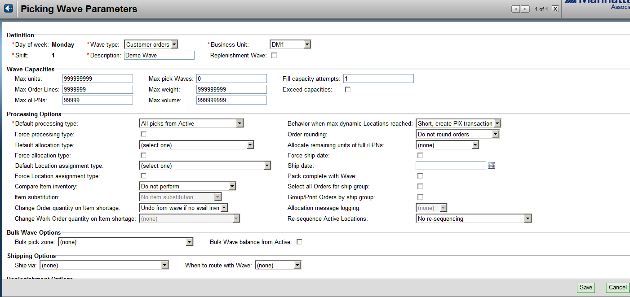
Picking Wave Parameters

Slide 23
Ship Wave Template
Description
Indicates which of the four wave types will be run when the ship wave is selected
Picking
Routing
Consolidation
Pack & Hold
Select a Picking Wave Parameter, which must have been previously defined

Slide 24
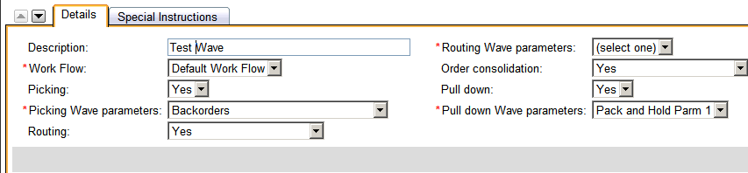
Ship Wave Template Details

Slide 25
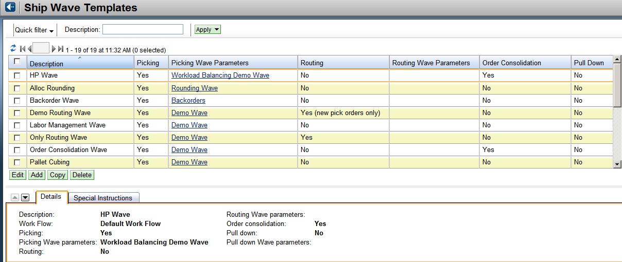
Ship Wave Template

Slide 26
Run Wave
Will determine which Distribution Orders will be selected based on rules
Rules define:
Selection and Sequencing
oLPN Label Print Grouping and Sequencing
Fill Wave Capacity

Slide 27
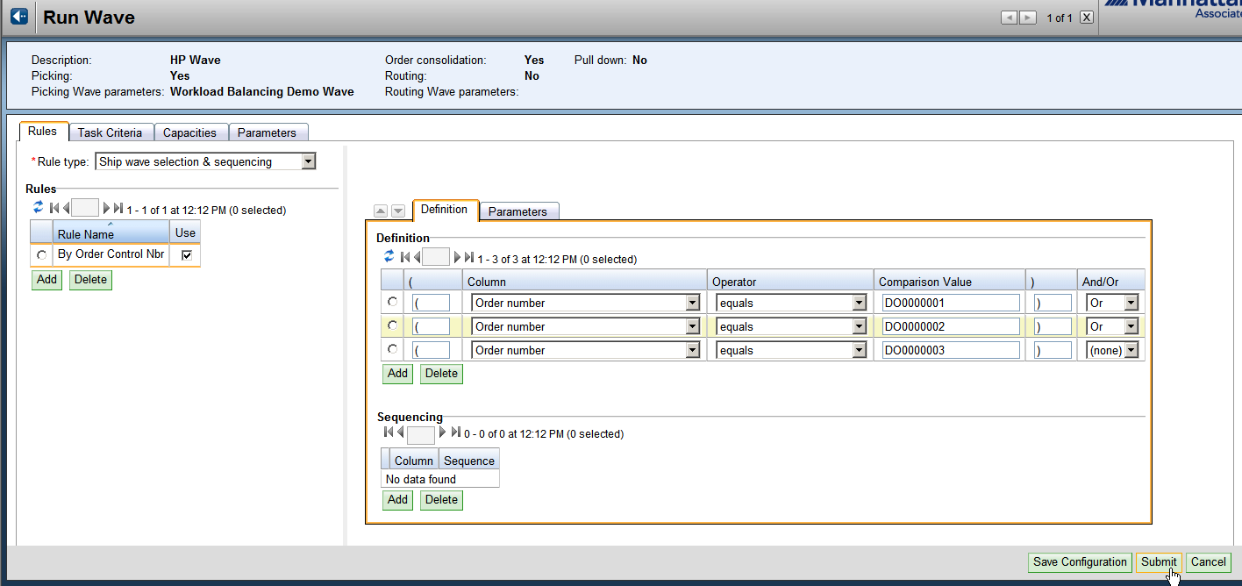
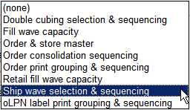
Run Wave
Rules are used to define which orders to select

Slide 28
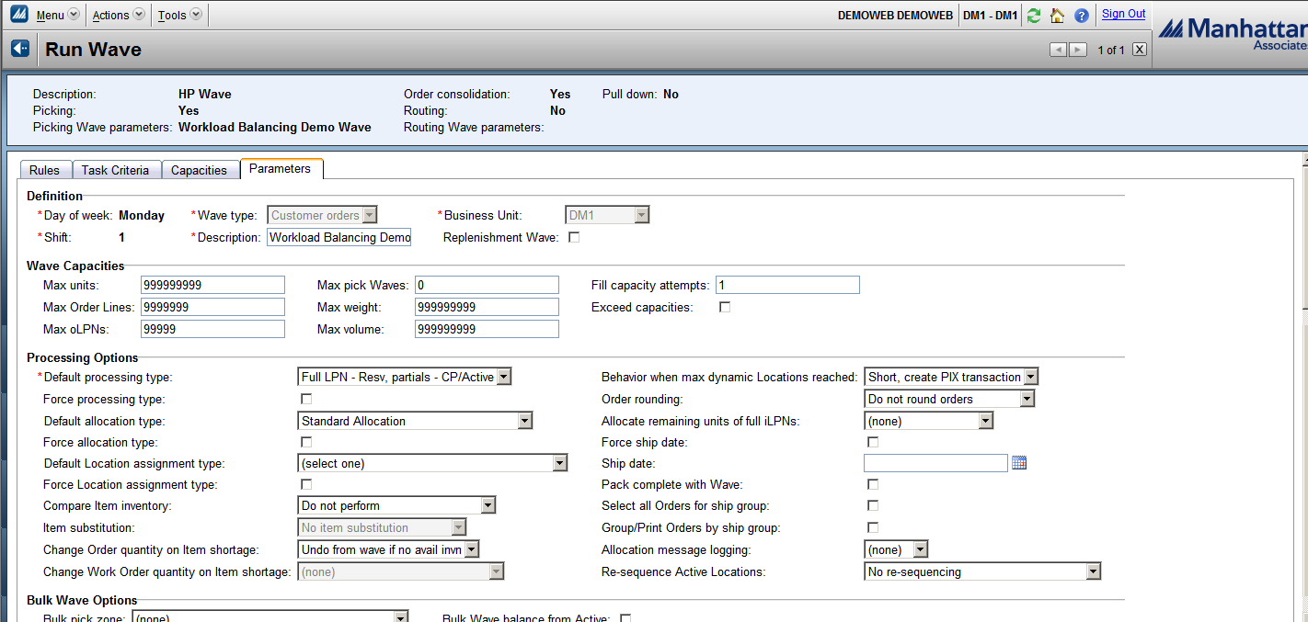
Run Wave
Parameters
Ability to modify parameters from picking wave template for this wave run

Slide 29
Run Wave
Click Submit to run wave

Slide 30
Wave Inquiry
Allows multiple wave functions to be performed in a single screen:
View
Undo Wave
End Wave
Restart Wave
Release Tasks

Slide 31
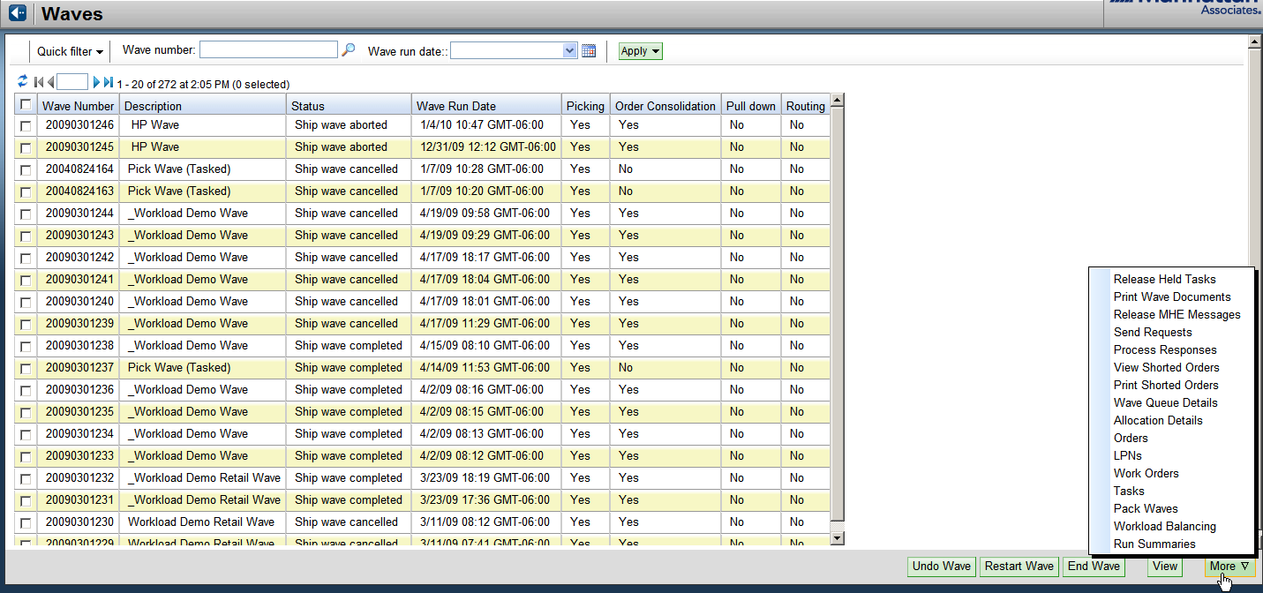
Wave Inquiry
“More” option: quick-link to frequently modified items

Slide 32
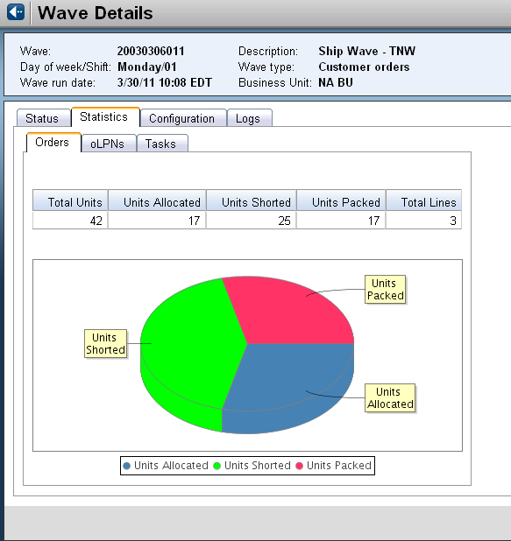
Wave Inquiry

Slide 33
Additional Wave Types
Pack Wave
Breaks a single pick wave into smaller pack waves
A Pack Wave will
Allocate inventory
Cube into oLPNs
Assign oLPNs to a chute

Slide 34
Additional Wave Types
Replenishment Wave
Generates all the required replenishment allocations and tasks for selected orders
A Replenishment Wave will
Allocate inventory
Create needs and tasks for replenishment

Slide 35
Task Definition
Task
Definition: System directed work!
Tasking involves the system initiation and direction of activities based on the following factors:
Type of work or task
Task priority
Worker eligibility
Type of equipment

Slide 36
Warehouse Areas

Slide 37
Common Tasks
Directed Putaway

Slide 38
Common Tasks
Full Case Pulls

Slide 39
Common Tasks
Pick From Active

Slide 40
Common Tasks
Replenishment

Slide 41
Common Tasks
Cycle Counting

Slide 42
Replenishment and Allocation

Slide 43
Agenda
Replenishment
Inventory Allocation
Task Creation

Slide 44
Replenishment
As inventory is consumed via the outbound process, Distribution Centers have automated processes designed to replace inventory no longer available
These processes, categorized as replenishment, are triggered either automatically within the WM system, or manually via user intervention

Slide 45
Replenishment – System Generated (cont.)
Is the need greater than available quantity? If so, the system will need to replenish before fulfilling orders
Is the need less than available quantity? Orders may be released, but quantities are monitored. Replenishment thresholds can be set
Is the need equal to available quantity? Orders may be released. Replenishment may trigger simultaneously
These scenarios are addressed within WM by assigning each a PRIORITY

Slide 46
Replenishment – System Generated
Replenishment Priorities
40: Replenishment before picking
50: Replenishment during picking
60: Replenishment anytime
Actual Qty = 20
TBP Qty = 30
Task Generated:
Priority = 40
Actual Qty = 20
TBP Qty = 250
Max Qty = 200
Tasks Generated:
Priority 40 and 50
Actual Qty = 20
TBP Qty = 15
Min Qty = 10
Task Generated:
Priority 60

Slide 47
Replenishment – Manually Triggered
Manual replenishment may also be used
Lean Time Replenishment:
best run in an “off peak” time
Users can specify a range of locations or a specific item
Conditions defined, such as “If Actual (Qty) < (some pre-defined percentage) of Maximum then replenish”

Slide 48
Inventory Allocation
Allocation Parameters (which iLPN)
Processing characteristics of the iLPNs selected for a specific INT and Priority
How allocation will react to mixed item iLPNs
Inventory Allocation Priorities (from where)
How to select inventory
Set up by INT, Allocation Method, and Priority

Slide 49
Inventory Allocation
Pull Zone
3 byte attribute assigned to reserve location for allocating inventory
Allocation Algorithm
Location
FIFO
LIFO
Ascending Quantity (Maximum number of pulls)
Descending Quantity (Minimum number of pulls)
Exceed Requirements Field
Do Not Exceed
Always Exceed
Process per Allocation Parameters

Slide 50
Inventory Allocation Priority Example
Inventory Allocation Priority Table
INT
PRIORITY
PULL ZONE
ALLOCATION METHOD
2 – Ship Against Order
1
LEFT
MIN # PULLS
Reserve Area
2 – Ship Against Order
2
MIDDLE
MIN # PULLS
1 – Replenish Active
1
RIGHT
MAX # PULLS
1 – Replenish Active
2
MIDDLE
MAX # PULLS
LEFT
MID
RIGHT
Pull Zones
Shipping Area
Active Picking Area

Slide 51
Task Creation
Rules-based statements to define and sequence task details into manageable groups of work
Specify task capacity such as:
4 iLPNs
1 Pallet
500 Lbs
Example: Task Capacity is 4 iLPNs. Replenishment needs 18 iLPNs. 5 tasks will be created.

Slide 52
Task Creation
TASK # | INT | PRIORITY | STATUS
XXXXXX | FULL CASE PULL (2) | 50 | RELEASED
XXXXXX | FULL CASE PULL (2) | 50 | RELEASED
XXXXXX | REPLENISH ACTIVE (1) | 40 | RELEASED
XXXXXX | REPLENISH ACTIVE (1) | 40 | RELEASED
XXXXXX | REPLENISH ACTIVE (1) | 40 | RELEASED
XXXXXX | REPLENISH ACTIVE (1) | 40 | RELEASED
XXXXXX | PICK FROM ACTIVE (50) | 50 | RELEASED

Slide 53

Task Creation
R12
R22
Order
10
Control Nbr: 100114
10
10
10
10
10
WPT: 5
10
10
10
10
10
10
Item Qty
10
Wii CONSOLE 12 Units
10
10
10
10
10
10
R11
10
R21
iPod 138 Units
10
10
UPDATES – INT 2
iLPN Consumed
oLPN Packed

Slide 54
Task Creation
Reserve
Active
R12
R22
10
One Step Method
10
10
10
10
10
10
10
10
10
10
10
10
10
10
10
10
10
10
R11
10
UPDATES – INT 1
One Step Method
iLPN Consumed in Active
Active ‘Actual Quantity’ Increases
Active ‘To Be Filled’ Decreases
R21
UPDATES – INT 1
Two Step Method
iLPN Consumed in Active
Active ‘Actual Quantity’ Increases
Active ‘To Be Filled’ Decreases
10
10
Staging Area
Two Step Method

Slide 55
CUBING

Slide 56
Outbound - Modules
Waves
Inventory Allocation and Replenishment
Cubing
Picking
Order Consolidation
Ship Confirmation
Transportation

Slide 57
Objectives
Define the concept
Identify the data elements required for Cubing functionality

Slide 58
Agenda
Overview
Methods of Cubing
Container Type Table
Order Requirements

Slide 59
Cubing
Cubing
Performed with the wave
Determine contents of outbound oLPNs before they are picked and packed
oLPNs created in status ‘Created’
oLPN label is the picking document

Slide 60
Cubing
Determine if cubing may be performed
Accurate item information?
Standard container sizes?
Irregular shaped items?
Use a lot of packing materials?

Slide 61
Agenda
Overview
Methods of Cubing
Container Type Table
Order Requirements

Slide 62
oLPN Cubing Indicator
oLPN Cubing Indicator
Field in the Order Header
Determines if and how an Order is to be cubed
Common oLPN Cubing Indicators
01 through 50 – Non-cubed Orders
51 – Pack oLPN to Capacity
61 – Pack oLPN without Mixed Items
62 – Pack oLPN without Mixed Style/Color
63 – Pack oLPN without Mixed Style
64 – Pack oLPN without Mixed Style/Style Suffix/Color
65 – Single Style, Maximum 5 Items
81 – 3D Cubing

Slide 63
Pack oLPN to Capacity
oLPN Cubing Indicator – Pack oLPN to Capacity
Works best for soft goods
Item weight, volume, and dimensions considered

Slide 64
Print Code 81 – 3D Cubing
Works best for hard goods
Item weight, volume, and dimensions considered
Advanced algorithm which addresses the physical size of the items being placed into containers in relation to each other

Slide 65
Agenda
Overview
Methods of Cubing
Container Type Table
Order Requirements

Slide 66
Container Type Table
Stores all Container Types and Sizes
Container Types
Single corrugated
Double corrugated
Padded Bag
Container Sizes
Small
Medium
Large
Container dimensions, weight and volume limits

Slide 67
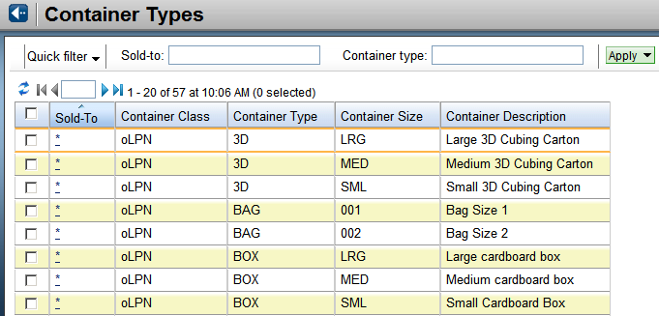
Container Type Table

Slide 68
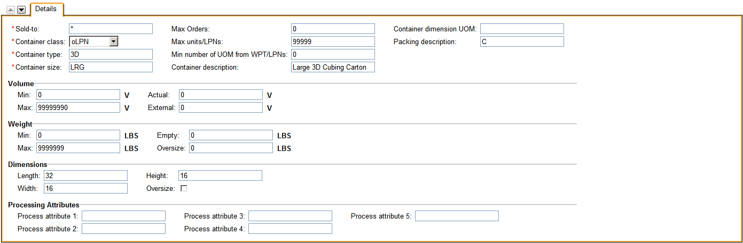
Container Type Table - Detail

Slide 69
Agenda
Overview
Methods of Cubing
Container Type Table
Order Requirements

Slide 70
Order Requirements
Order Header
oLPN Cubing Indicator
Order Detail
Critical Dimensions
Length, Width, Height
Unit Weight, Unit Volume
Container Type (optional)
oLPN Break Attribute (optional)
Cube Multiple Quantity (optional)
Notes:
23

Slide 71
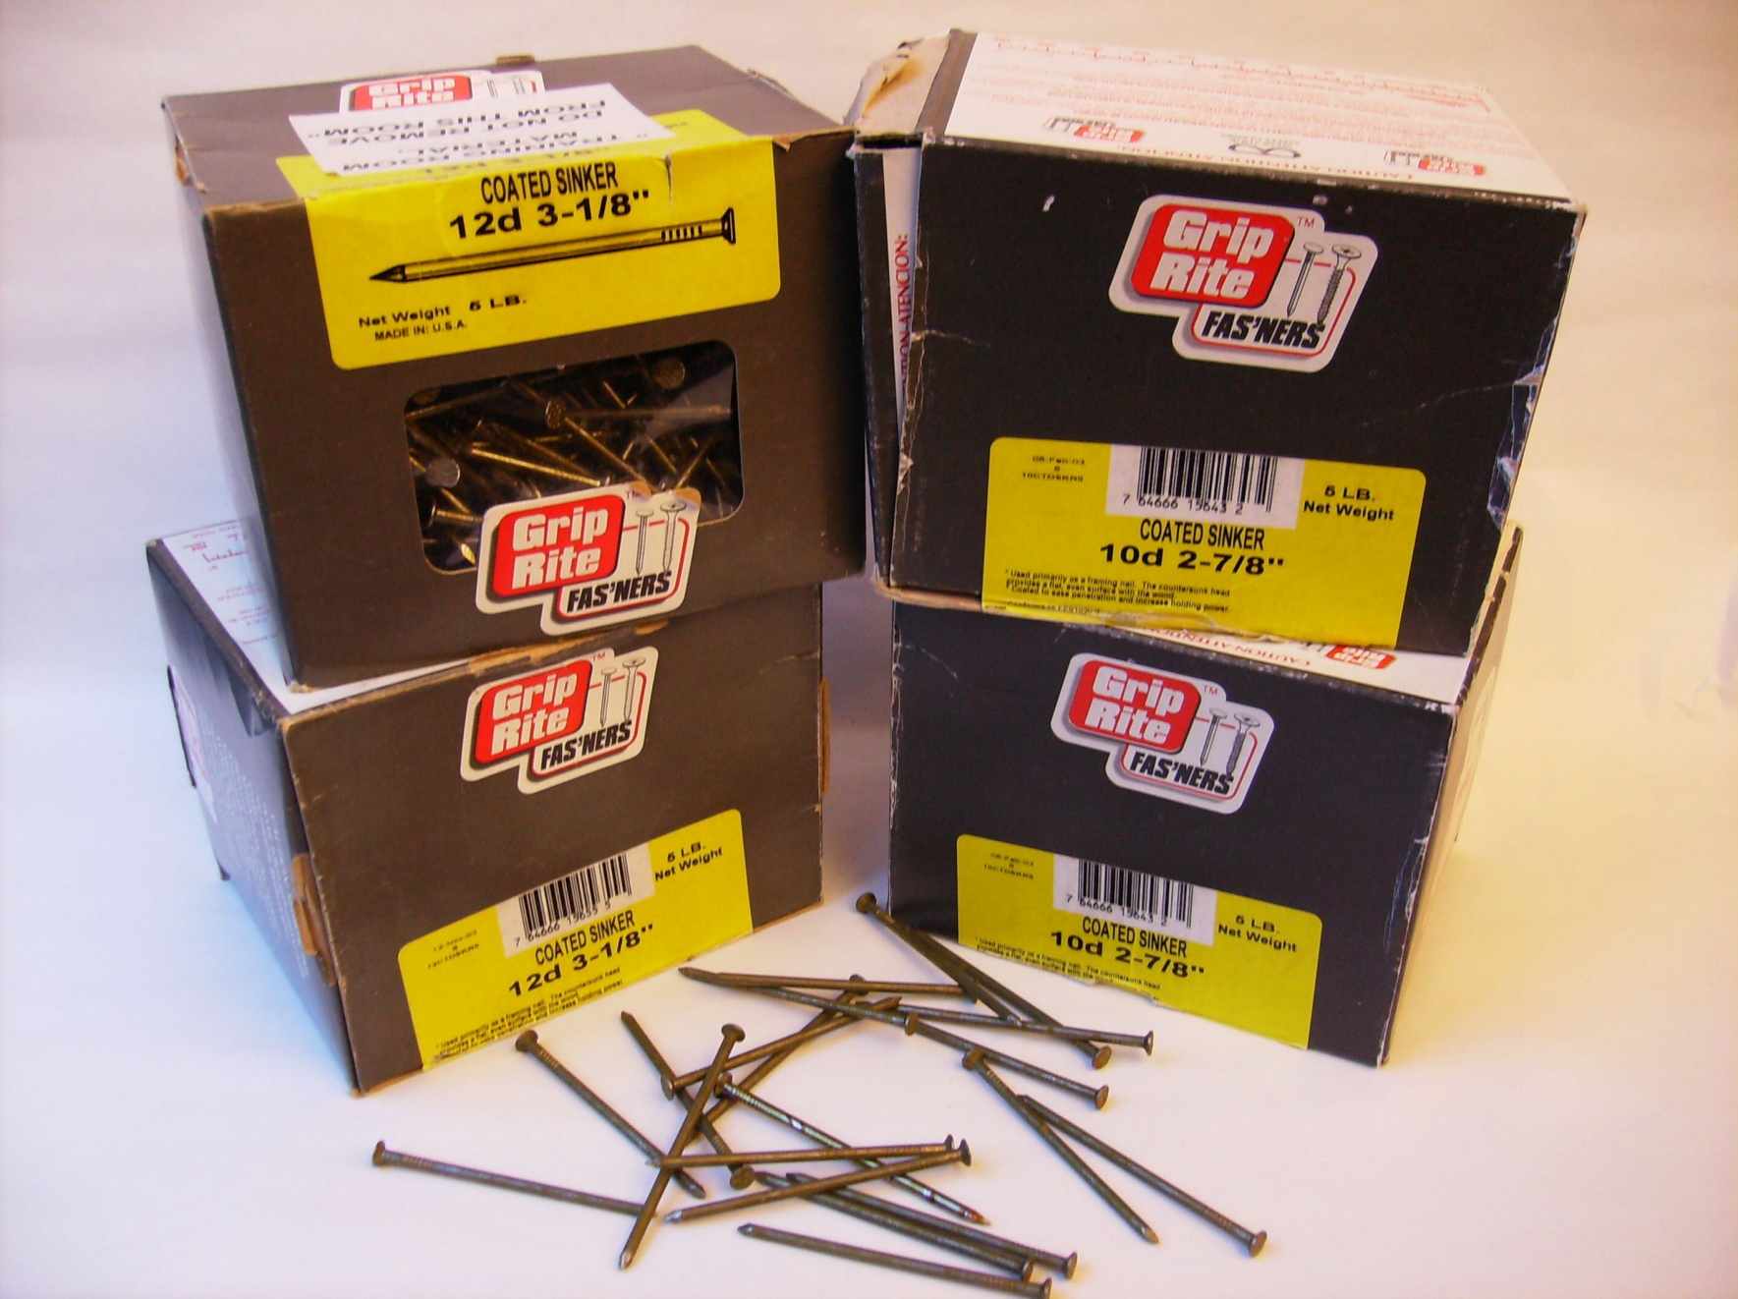
Cubing - Nails

Slide 72

Cubing - Boots

Slide 73

Cubing – Pot Feet

Slide 74
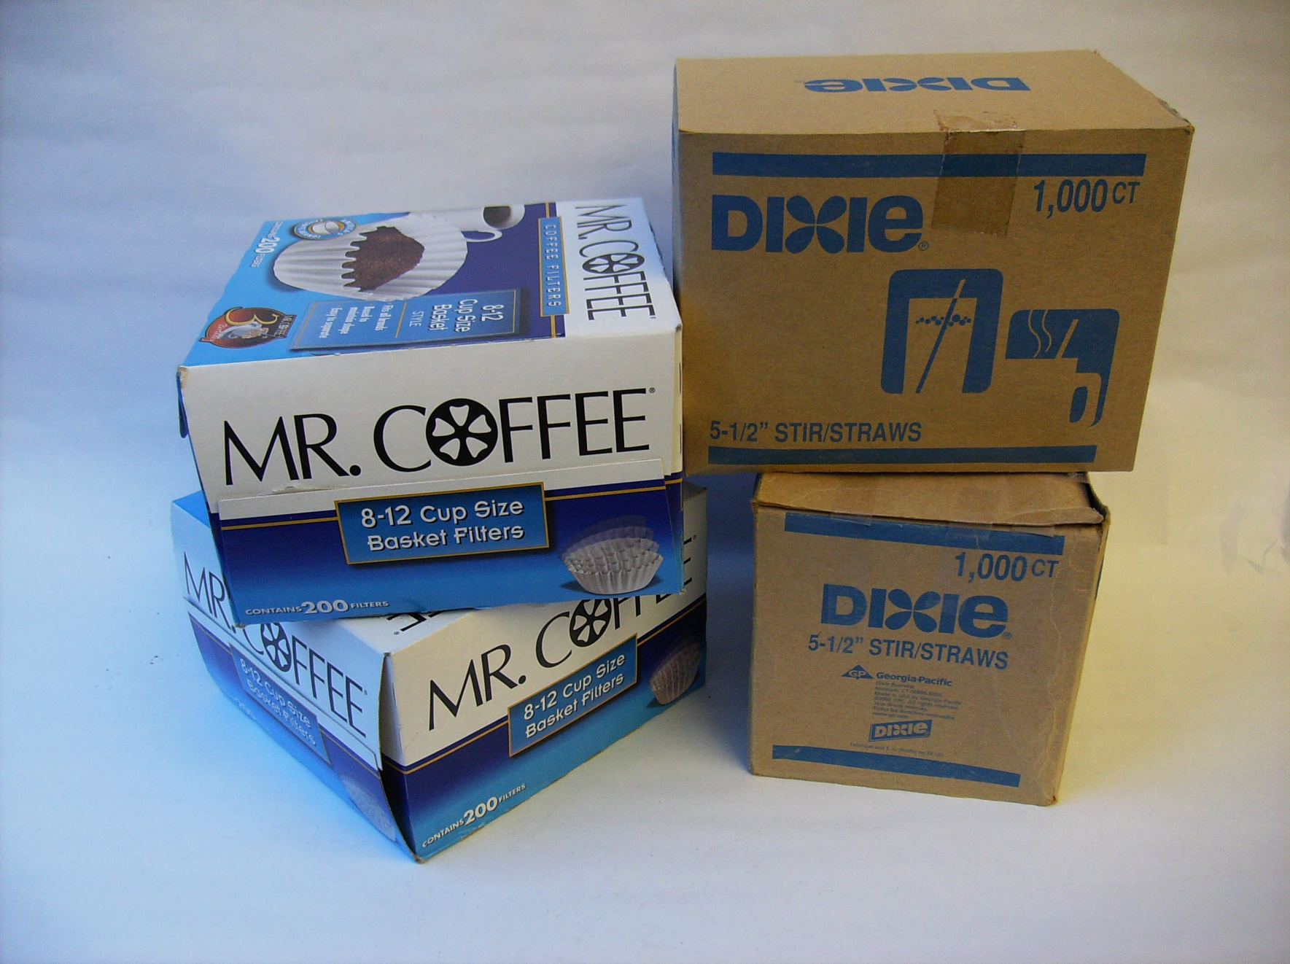
Cubing – Coffee/Stir Sticks

Slide 75
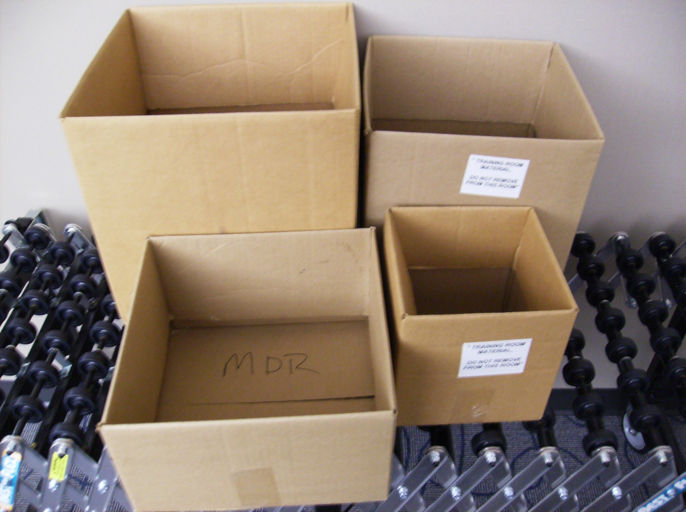
Cubing – Containers

Slide 76
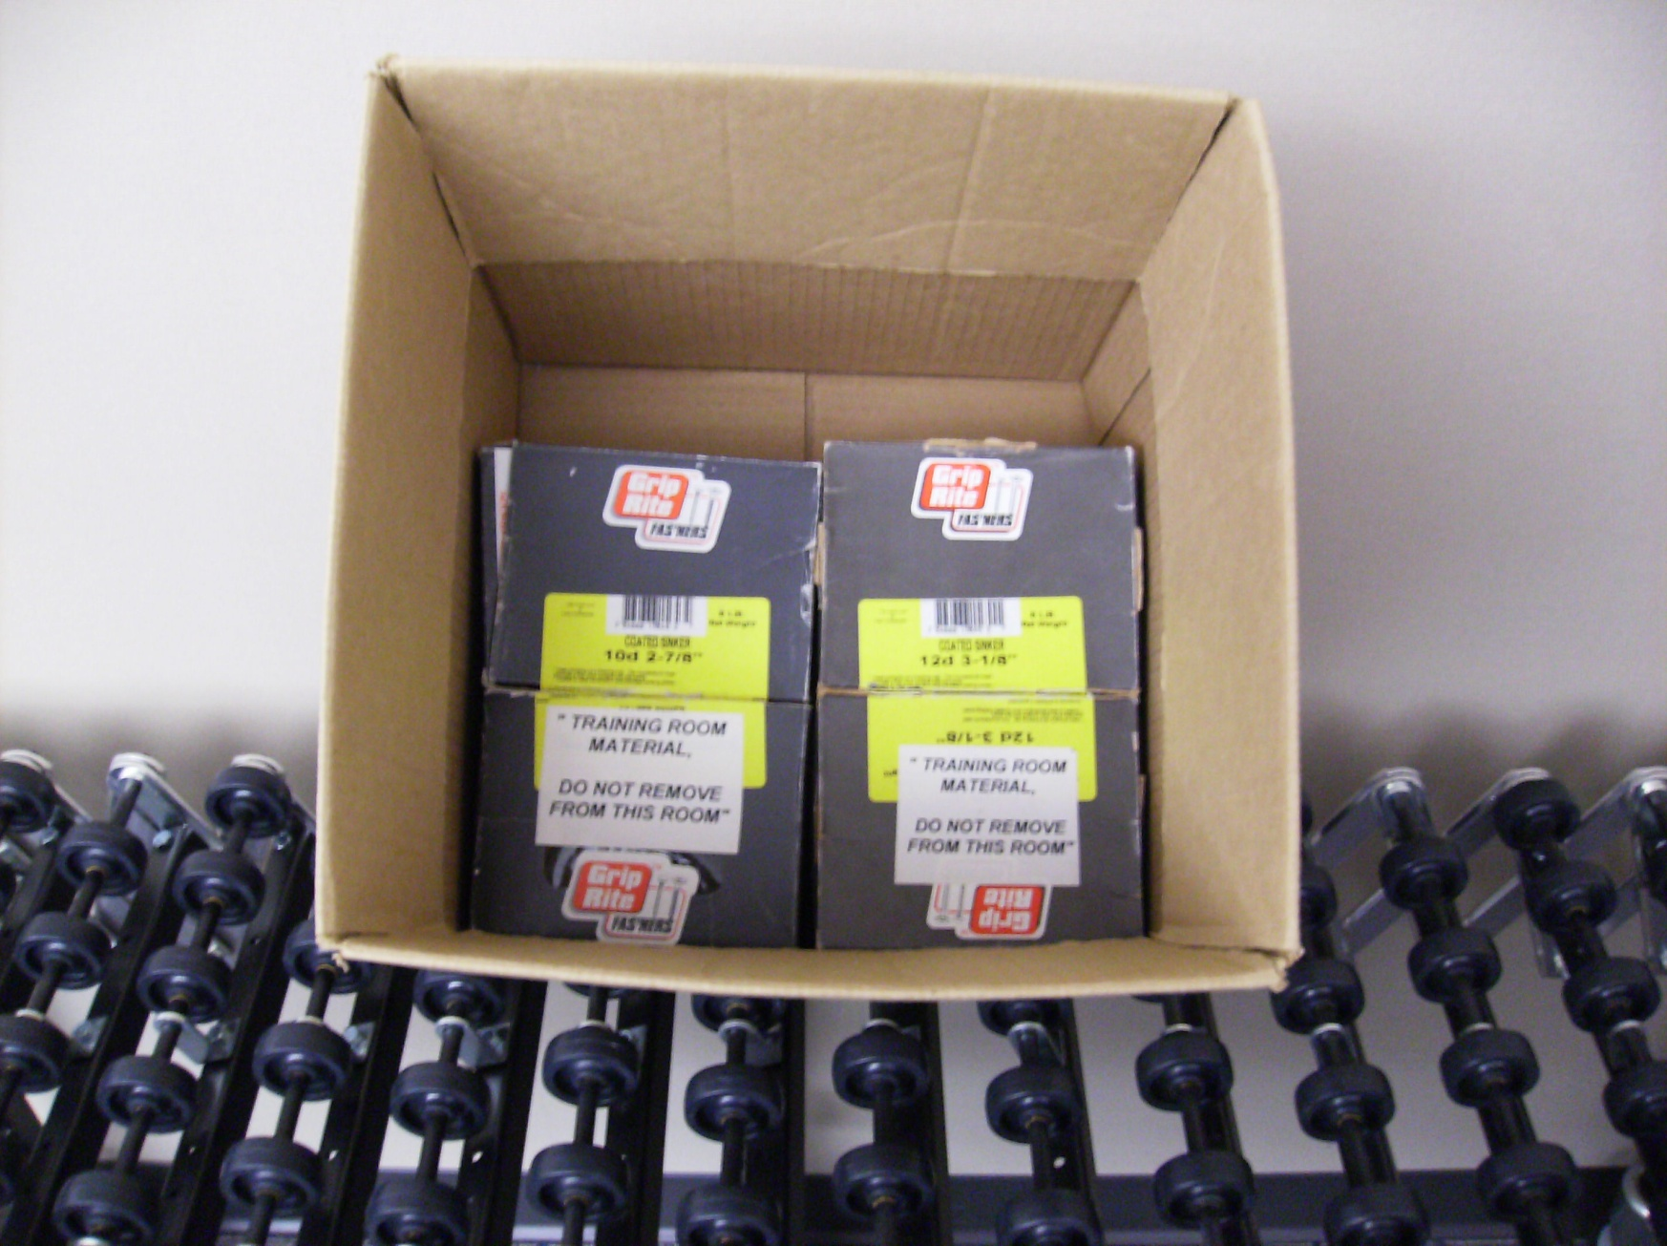
Cubing – Cubed Nails

Slide 77
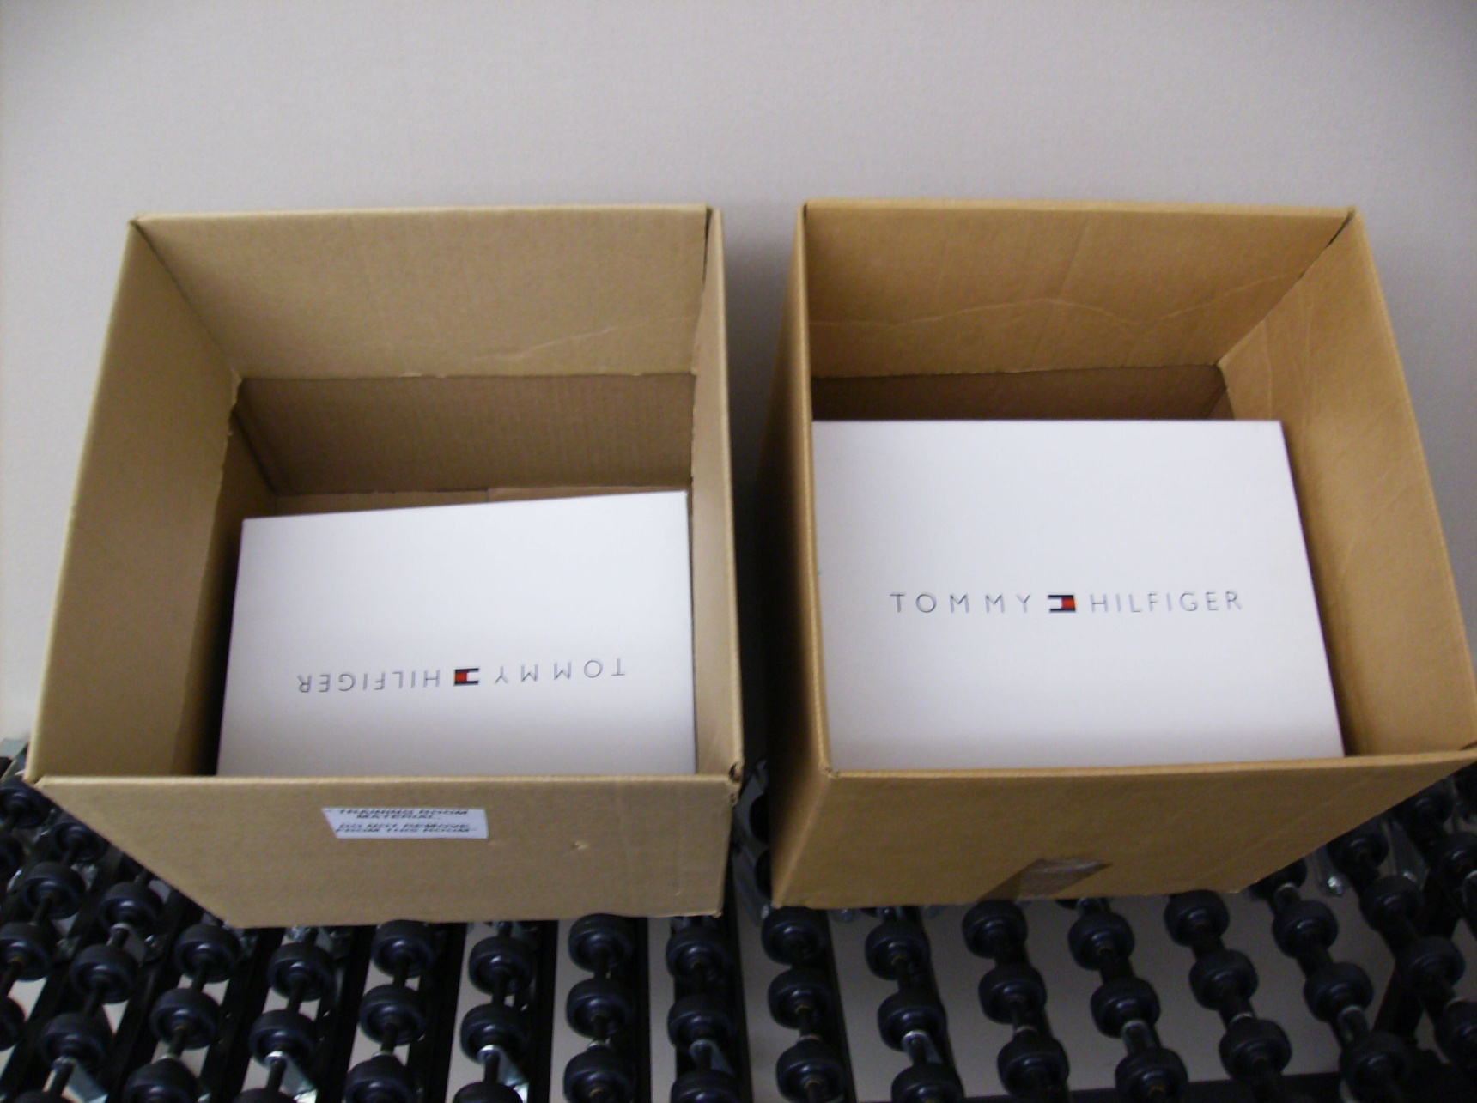
Cubing – Cubed Boots

Slide 78
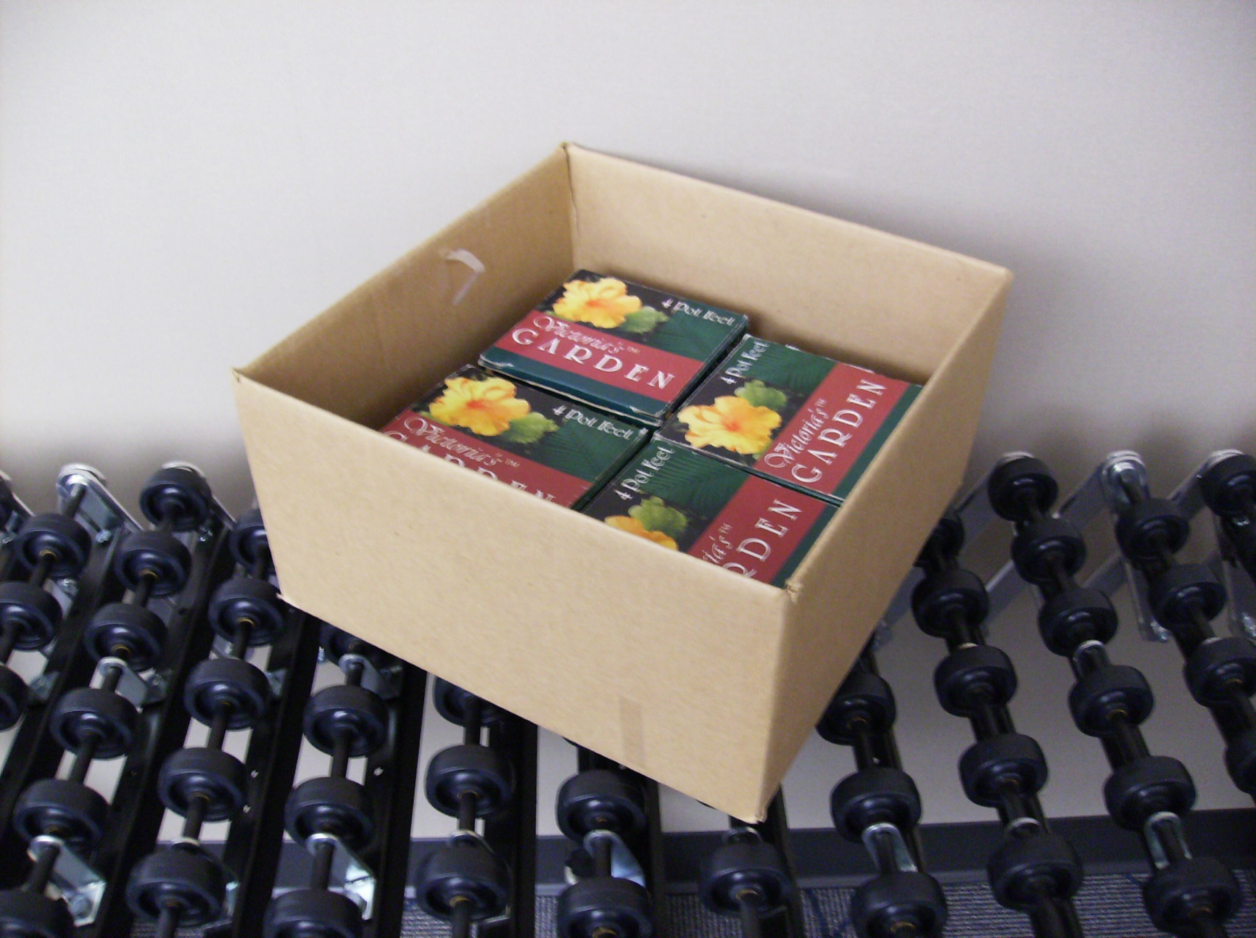
Cubing – Cubed Pot Feet

Slide 79
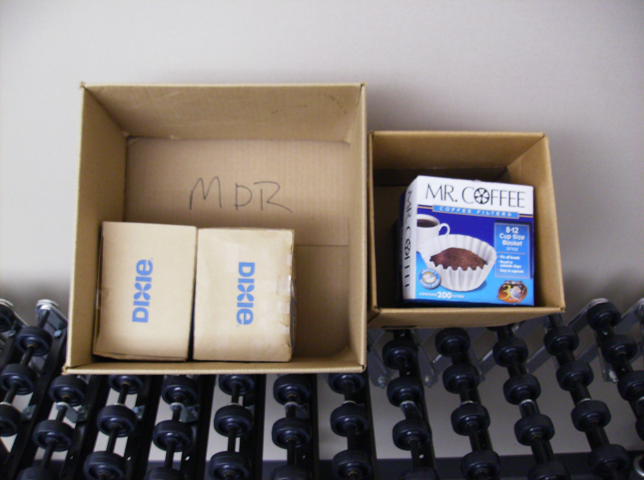
Cubing – Cubed Filters/Stir Sticks

Slide 80
PICKING

Slide 81
Outbound - Modules
Waves
Inventory Allocation and Replenishment
Cubing
Picking
Order Consolidation
Ship Confirmation
Transportation

Slide 82
Objectives
State the difference between manual picking and RF picking
State the difference between cubed orders and non-cubed orders
Define the four methods of picking from active and describe situations where each would be best used
Name options used to handle picking and packing exceptions that may arise during normal operations

Slide 83
Agenda
Picking and Packing Combinations
Picking Updates
Methods of Picking
Picking and Packing Exceptions Handling

Slide 84
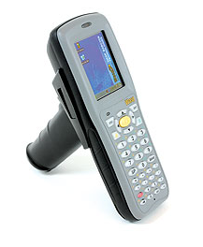
RF Picking vs. Manual Picking
RF Picking
Real time updates to actual inventory as units are picked
Manual Picking
Lag time between physically picking inventory and updating actual quantities in active location
WM inventory updated at the packing station

Slide 85
Non-Cubed Orders vs. Cubed Orders
Cubed Orders
WM determines container size and contents
Users pick orders using oLPN labels
oLPN Content labels can be printed for additional visual verification
Non-Cubed Orders
Users pick items using Orders and determine the items and quantities packed in each container

Slide 86
Agenda
Picking and Packing Combinations
Picking Updates
Methods of Picking
Picking and Packing Exceptions Handling

Slide 87
Picking Updates
Active Location Updates –
- Current quantity decreases
- To Be Picked quantity decreases
oLPN Updates –
- Packed quantity increases
- oLPN Status updated to ‘Packed’
Order Updates –
- Units Packed increases
- Order Status from ‘In Packing’ to ’Packed’’

Slide 88
Agenda
Picking and Packing Combinations
Picking Updates
Methods of Picking
Picking and Packing Exceptions Handling

Slide 89
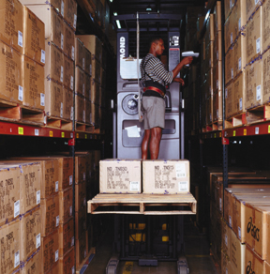
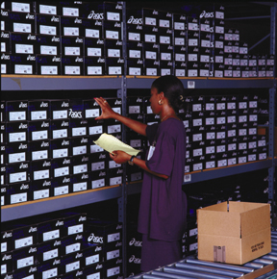
Methods of Picking
Methods of Picking
Single Order Picking
Batch Picking
Zone Picking
Bulk Wave Picking

Slide 90
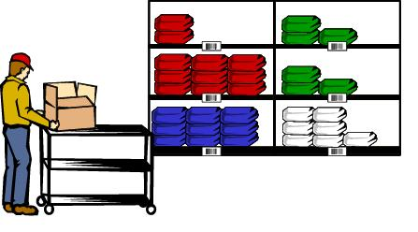
Methods of Picking
Single Order Picking
Workers pick a single order to completion
Example
Manually picked using Orders
Sent to a packing station to pack

Slide 91
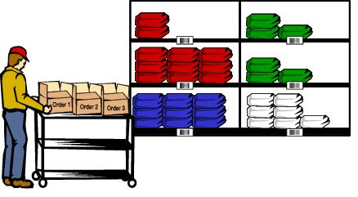
Methods of Picking
Batch Picking
Pick multiple oLPNs/orders at the same time
Example
Multiple oLPNs are picked during a single trip through the active area

Slide 92
Methods of Picking
Zone Picking
Each worker picks product from the area to which they are assigned
Cubed Example
A user scans an oLPN
WM directs the user to pick items in their zone
After all items are packed for that zone, the user is directed to pass the container to the next zone
Active Pick Area
RF Pick/Pack

Slide 93
Methods of Picking
Bulk Wave Picking
A bulk quantity of products for multiple orders is pulled from reserve and/or active locations to a dynamic location. Orders are picked from this location
Reserve
Case Pick
Active
Pull List
Picking/Packing
Pull List
Packing Stations

Slide 94
Agenda
Picking and Packing Combinations
Picking Updates
Methods of Picking
Picking and Packing Exceptions Handling

Slide 95
Exceptions Handling
Exceptions
Packing the wrong items into containers
Shorting an order when inventory is available
Items cubed into improperly configured containers
Exception Handling methods are as follows

Slide 96
Exceptions Handling
Split/Combine oLPN
RF option
Same Order Control Number
To existing or new oLPN
Modify oLPN Contents
Container type or size
Item quantity
Add items
UI option

Slide 97
Exceptions Handling
Outbound Quality Audit
Confirms accuracy and quality of oLPNs
Outbound Quality Audit Table
Rules determine number of oLPNs to audit for given criteria
Can apply lock codes to oLPNs requiring QA
Check accuracy using RF Audit oLPN

Slide 98
ORDER CONSOLIDATION

Slide 99
Outbound - Modules
Waves
Inventory Allocation and Replenishment
Cubing
Picking
Order Consolidation
Ship Confirmation
Transportation

Slide 100
Agenda
Overview
Order Consolidation Locations
Configuration

Slide 101
Overview
Order Consolidation is the assignment of an outbound location to oLPNs with similar characteristics
Consolidate:
Multiple oLPNs of a single order
Multiple orders
Packed in various areas of the warehouse

Slide 102
Overview
Can occur:
Real time
With Ship Wave
Case Pick
Reserve
To Shipping

Slide 103
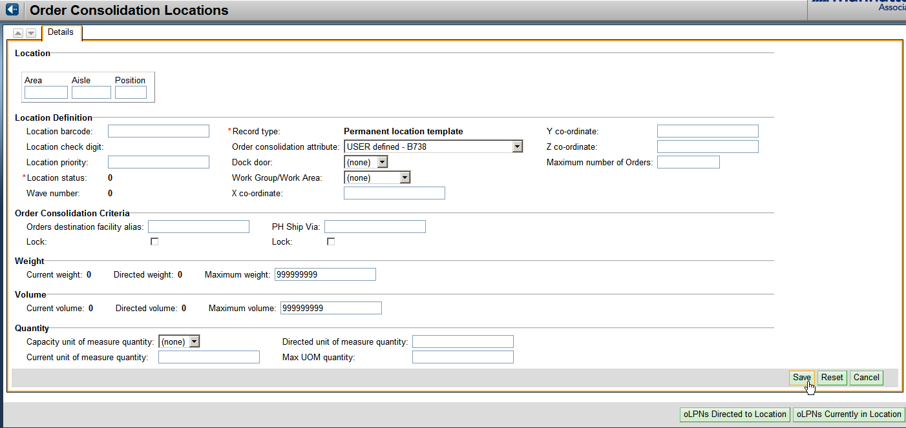
Order Consolidation Locations
Two types of consolidation locations:
Temporary
Permanent

Slide 104
Configuration
Location Templates
All locations must have a template
When the first oLPN is assigned to a location, the system copies the template to a new work row
Work rows contain the most up-to-date information about locations

Slide 105
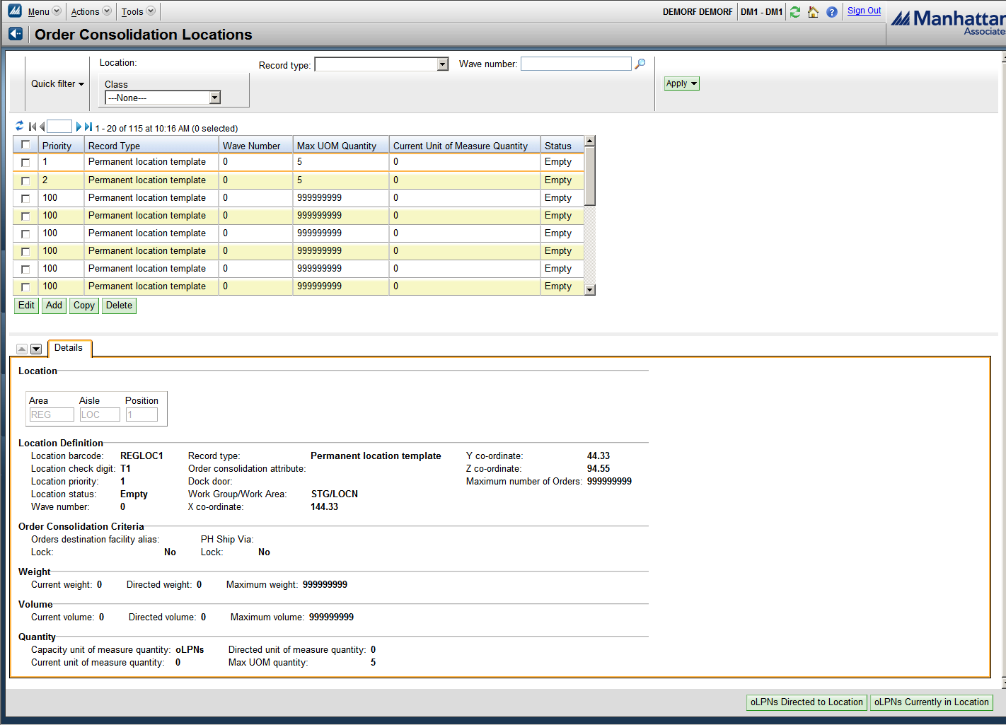
Location Templates
“Add” or “Edit” Location Templates here
Scrolling to the bottom of the screen displays a View or Modify field for these templates

Slide 106
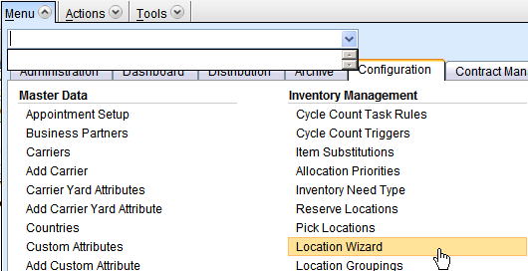
Locations: Creation, Configuration and Maintenance
Locations are created and maintained within the Location Wizard
The Location Type will determine if a location will be used for Order Consolidation

Slide 107
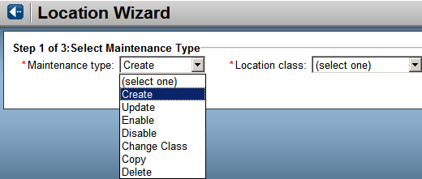
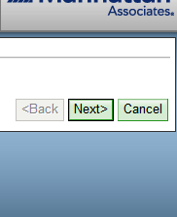
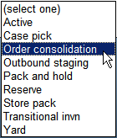
Locations: Creation, Configuration and Maintenance
First pull-down defines the type of work you intend to perform…
…and the Class defines the type of Location

Slide 108
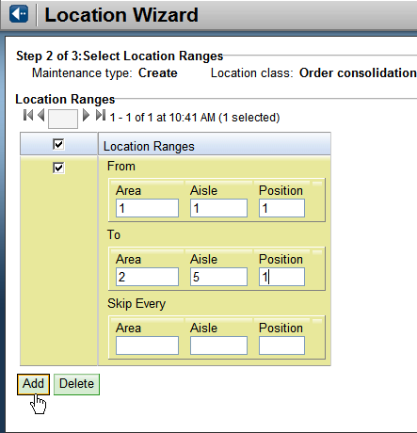
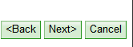
Locations: Creation, Configuration and Maintenance
If creating a new location, step 2 will ask you to define the locations in the Warehouse

Slide 109
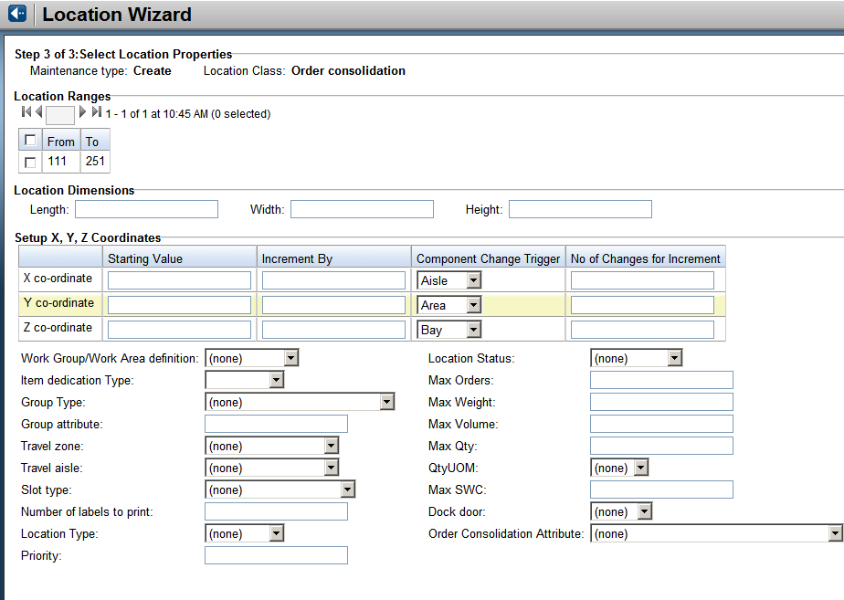
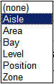
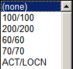
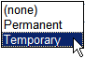
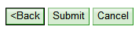
Locations: Creation, Configuration and Maintenance
The final step will allow you to create/modify more specific information about the location
Definition of coordinates
Work Group Definition
Type: Temporary or permanent

Slide 110
Manifesting

Slide 111

Manifesting Templates
Weigh and Manifest oLPN UI | Allows users to manually manifest oLPN
 | User can capture actual weight User can capture container type change
 | Used to manifest parcel oLPN’s manually
MHE Manifest – Container Status | Allows MHE message to manifest oLPN
 | Message can capture actual weight
 | Used to manifest parcel oLPN’s through MHE shipping sorter

Slide 112
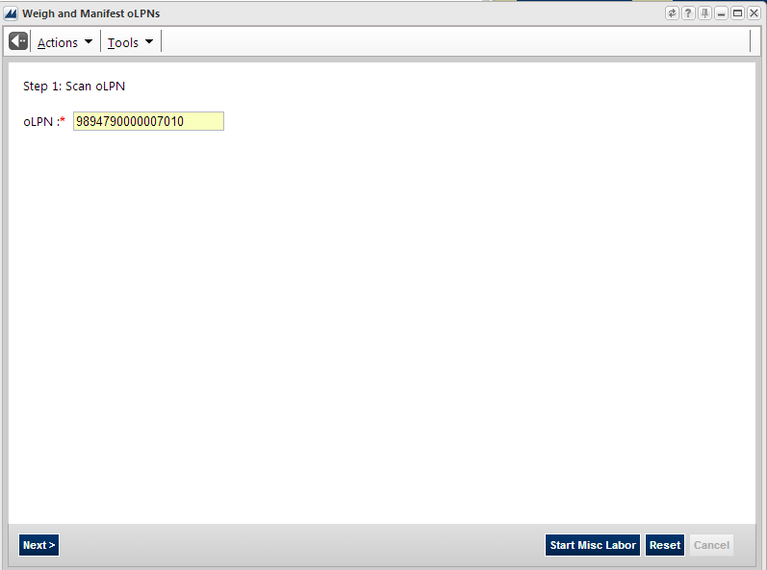
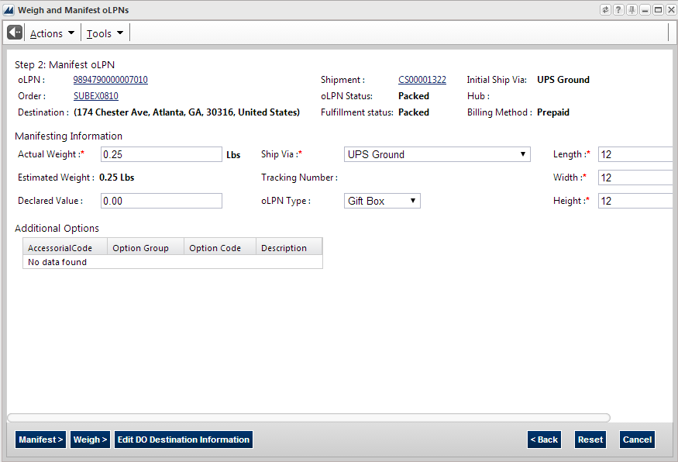
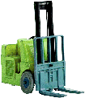
Weigh and Manifest oLPN UI
User captures oLPN Number
User captures actual weight, final ship via, final oLPN type and manifests oLPN
Notes:
Case Inventory
A case in WM is a moveable unit in the warehouse with a tracking number or label. WM can track many different physical objects as cases, for example:
• A box
• A box on a pallet
• A pallet
• A trolley holding shirts
• A plastic bin

Slide 113
SHIP CONFIRMATION

Slide 114
Outbound - Modules
Waves
Inventory Allocation and Replenishment
Cubing
Picking
Order Consolidation
Ship Confirmation

Slide 115
Objective
Describe the methods used to confirm order shipment

Slide 116
Agenda
Overview
Ship Confirmation:
Manual
Ship Confirmation Rules
Ship Confirmation Parameters
Close Shipment / RF Close

Slide 117
Overview
Ship Confirmation:
Updates Distribution Orders to status of ‘shipped’
Creates output XML files for host processing
Host
(ERP System)
WM

Slide 118
Overview
Ship Confirmation can occur several different ways
Manually
Automatically (Ship Confirmation Parameters )
Using Ship Confirmation Rules
During Freight Processing - Close Shipment and/or RF Close

Slide 119
Agenda
Overview
Ship Confirmation:
Manual
Ship Confirmation Rules
Ship Confirmation Parameters
Close Shipment / RF Close

Slide 120
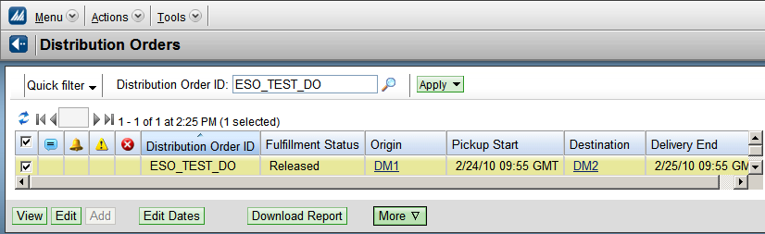
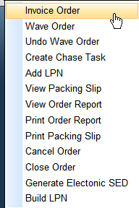
Manual Confirmation
Under Distribution Orders
Invoice Order action (pull-down under “More”)
Can select multiple Orders

Slide 121
Agenda
Ship Confirmation:
Manual
Automatic (Ship Confirmation Parameters)
Ship Confirmation Rules
Close Shipment / RF Close

Slide 122
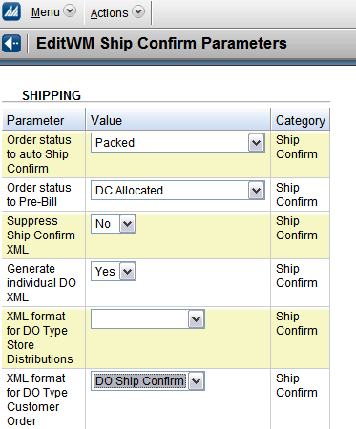
Automatic Confirmation
Parameters
Set order status for:
Ship Confirm
Pre-Bill
Set Format Options for:
Distribution Orders
Store Distributions
Warehouse Transfers
Returns to Vendor

Slide 123
Agenda
Ship Confirmation:
Manual
Automatic (Ship Confirmation Parameters)
Ship Confirmation Rules
Close Shipment / RF Close

Slide 124
Ship Confirmation Rules
Confirms groups of orders
Set up an ‘event’ which consist of 1 or more rules
Rules use fields to define which orders will be updated

Slide 125
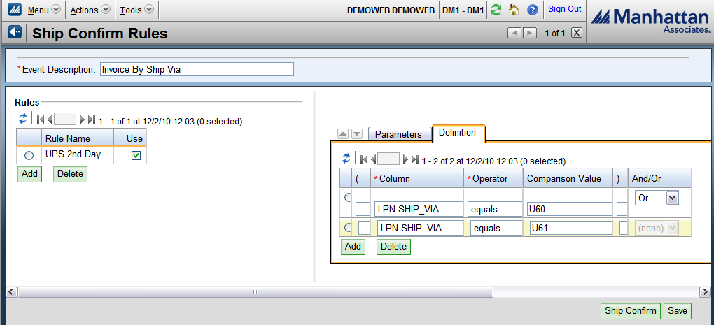
Ship Confirm Rules

Slide 126
Agenda
Ship Confirmation:
Manual
Automatic (Ship Confirmation Parameters)
Ship Confirmation Rules
Close Shipment / RF Close

Slide 127
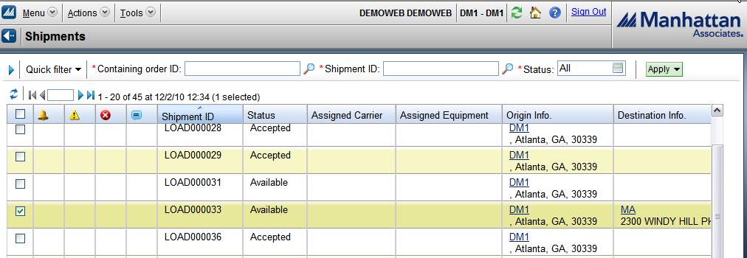
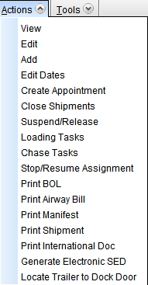
Close Shipment
Shipment Inquiry
Select Shipment
Choose ‘Close Shipment’ as an Action

Slide 128
Task Initiation

Slide 129
Task Execution
System Determined
The user is displayed one or multiple tasks (based on the user profile), their priority and work area. The associate enters the task number to complete.
Select Task
Task Pr Area
1 00TRF00121 40 Photo
2 00TRF00122 40 Photo
3 00TRF00123 40 Photo
4 00TRF00124 40 Photo
S=> __
User Determined
TASK#:________
LPN:
_____________________
The user can enter either the Task Number or the LPN number to find the associated task.

Slide 130
Make Pick Cart
Make Pick Cart
Pick Cart #:
PICKCART03__________
WM prompts for the pick cart number and user enters the pick cart number
Make Pick Cart
Pick Cart #:
PICKCART03
oLPN:
00000999990000012345
WM prompts for oLPN to add to cart. User scans oLPN barcode to confirm the oLPN.
Make Pick Cart
Pick Cart #:
PICKCART03
oLPN:
00000999990000012345
Slot:
1___
For slotted pick carts, WM prompts for the slot to which the oLPN is located within the cart. User key enters the slot to confirm.

Slide 131
Make Pick Cart
Make Pick Cart
Pick Cart #:
PICKCART03
oLPN:
00000999990000012399
The user can scan an oLPN already in packing (zone pick and pass).
--------Info--------
| oLPN Will Be |
| Removed From Task|
| 411473 |
--------------------
WM notifies the user the oLPN will be removed from the previous task. User executes CTRL-A to confirm.
Make Pick Cart
Pick Cart #:
PICKCART03
oLPN:
00000999990000012345
Slot:
1___
WM subsequently directs user to confirm the slot for this newly assigned oLPN.

Slide 132
Make Pick Tote Cart
Make Pick Cart
Pick Cart #:
PICKCART04
Tote:
F1542TOTE1_________
WM prompts for tote to add to cart. User scans tote barcode to confirm the tote id.
Make Pick Cart
Pick Cart #:
PICKCART04
Tote:
F1542TOTE1
Slot:
1___
WM prompts for the slot to which the tote is located within the cart. User key enters the slot to confirm.
Make Pick Cart
Pick Cart #:
PICKCART04
Tote:
F1542TOTE1
Slot:
1
Task:_________
WM prompts for the Pick Tote task to associate to the tote slotted to the pick cart. User executes CTRL-S to see available pick tote tasks.

Slide 133
Make Pick Tote Cart
Make Pick Cart
Seq Task#
1 411496
2 410390
3 411493
Select=>2__
WM displays list of available pick tote tasks. User enters sequence number for selected task.
--------Info--------
| Task Added To |
| Tote |
--------------------
WM confirms task is added to tote.

Slide 134
Reserve Pulls

Slide 135
iLPN Pulling from Reserve
Replenishment
INT 1 – From Reserve to Active
INT 9 – From Reserve to Case Pick
Bulk Pulls from Reserve for Retail
INT 53 – From Reserve to Put-to-Store
Pulling for Orders
INT 2 – Full UOM from Reserve to Shipping

Slide 136
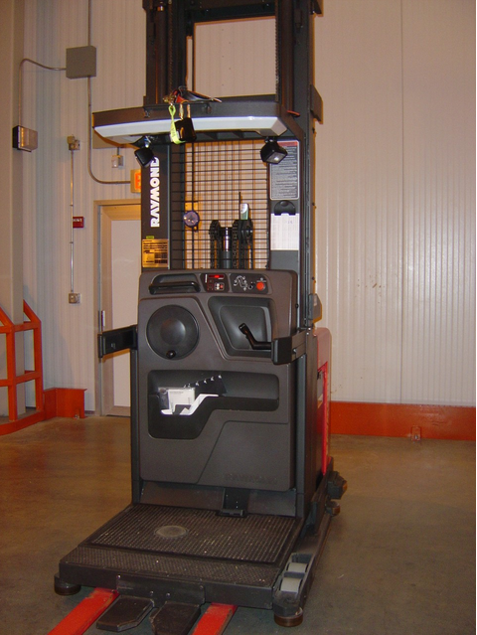
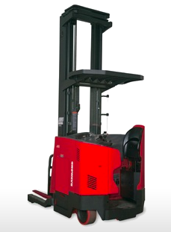

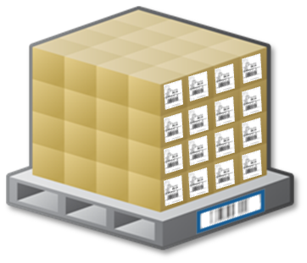




Pulling Templates
Pull Full Pallet by Pallet ID
Pull iLPNs to Pallet
Pull for Pallet by LPN ID
Notes:
Case Inventory
A case in WM is a moveable unit in the warehouse with a tracking number or label. WM can track many different physical objects as cases, for example:
• A box
• A box on a pallet
• A pallet
• A trolley holding shirts
• A plastic bin

Slide 137
Pull iLPNs to Pallet
Pallet:
PLT000999051_________
User picks up a pallet and scans a blind pallet label
Task:3304
Rloc: AZ-01-02-22
Item:09120216027
Qty: 10 Unit
INT: 1 Repl Activ
iLPN:
00099900000000000300
00099900000000000300
WM directs the user to the location and iLPN. The user scans the iLPN (or substitute LPN) to confirm. This is repeated for all LPN’s on the task.
Inventory Movement
Task#:3304
Container:
PLT000999051
WG/WA:DROP/WACA
Rloc:DROP0001_______
When all pulls are done, WM displays either a drop zone or the final destination depending on the task path. The user scans the location to confirm the put.

Slide 138
Pull iLPNs to Pallet
Task:3304
Container:
PLT000999051
Rloc:DR-OP-00-01
Container:
PLT000999051________
If the pallet is placed into a drop zone, a second user is directed to the drop zone to pick up the pallet. The user scans the pallet to confirm pick-up.
Fill Active Plt
Aloc:CA-01-04-13
LPN:
00099900000000000202 Item:40014547822
Quantity: 6 Unit
Aloc:CA010413_______
WM displays the puts in pick location sequence. WM displays the iLPN to put and the forward pick location. The user scans the location to confirm correct location.
LPN:
00099900000000000202 Item:40014547822
Quantity: 6 Unit
Quantity: 6 Unit
LPN:
00099900000000000202
If there are multiple iLPNs on the pallet, WM prompts the user to scan the iLPN. The user scans the iLPN to confirm the put to the forward pick location.

Slide 139
Pulling full iLPN / Pallet
Rloc:AZ-01-02-23
Item:40014547886
Nbr iLPNs:4
Batch:*
Pallet:
PLT000999003
PLT000999003________
WM directs the user to the location and iLPN or Pallet iLPN. The user scans the iLPN or Pallet iLPN to confirm.
Inventory Movement
Task#:3295
Container:
PLT000999003
WG/WA:DROP/WACA
Rloc:DROP0001_______
When all pulls are done, WM displays either a drop zone or the final destination depending on the task path. The user scans the location to confirm the put.

Slide 140
Pulling full iLPN / Pallet
Rloc:AZ-01-02-23
Item:40014547886
Nbr iLPNs:4
Batch:*
Pallet:
PLT000999003
PLT000999003________
WM directs the user to the location and iLPN or Pallet iLPN. The user scans the iLPN or Pallet iLPN to confirm.
Inventory Movement
Task#:3295
Container:
PLT000999003
WG/WA:DROP/WACA
Rloc:DROP0001_______
When all pulls are done, WM displays either a drop zone or the final destination depending on the task path. The user scans the location to confirm the put.
Task:3295
Container:
PLT000999003
Rloc:DR-OP-00-01
Container:
PLT000999003________
If the pallet is placed into a drop zone, a second user is directed to the drop zone to pick up the pallet. The user scans the pallet to confirm pick-up.

Slide 141
Pulling full iLPN / Pallet
Fill Active Plt
Aloc:CA-01-05-11
LPN:
PLT000999003
Quantity:
Aloc:CA010511_______
WM displays the pallet to put and the forward pick location. The user scans the location to confirm correct location.

Slide 142
Forward Pick Pulls

Slide 143
Pulling from Forward Active
Replenishment
INT 3 – From Case Pick to Active
Bulk Pulls from Active for Retail
INT 54 – From Active to Put-to-Store
Pulling for Orders
INT 50/55 – From Active to Tote
INT 51/56 – From Case Pick to Tote

Slide 144
Pull to iLPN
Pck iLPN Frm CP
Task:4110
Cloc:CP-BC01-01-1-1
Item:CAM1000
Qty:20 Unit
Cloc:CPBC010111_____
For tasked pulls from forward pick locations, WM directs the user to the first location, SKU and quantity and has the user confirm the location.
Pck iLPN Frm CP
iLPN:
ILPN001234__________
WM then directs the user to confirm the iLPN into which the inventory will be pulled out.
Pck iLPN Frm CP
iLPN:
ILPN001234
Item:CAM1000
Qty:20 Unit
Qty Pckd:20__ Unit
WM directs the user to confirm the quantity pulled from the location to the iLPN. This process is repeated for each task detail.

Slide 145
Pull to iLPN
Fill Actv
Aloc:AA01-B2-L2
LPN:
ILPN001234
Item:CAM1000
Quantity:20 Unit
Aloc:AA01B2L2_______
WM directs the user to the forward pick location in which to replenish the SKU and Quantity (INT 3). The user scans the location to confirm the fill.

Slide 146
Pick to Tote
Pick to Tote
Task:
160565
Tote:
TOTE12345___________
User picks up a pallet, gaylord or tote and scans a blind Tote LPN label
Pick to Tote
Tote:
TOTE12345
Aloc: PS-10-9-2
Item:CAM1000
Qty: 1 unit
Qty: 1 unit
WM directs the user to the forward pick location, SKU and Quantity. The user key enters the quantity. This is repeated for each task detail.
Tote:
TOTE12345
Locn:_______________
WM is complete with the tote or directs the user to fill the tote contents to a dynamic active user directed location (configurable).

Slide 147
Pick Tote Cart
Tote:
*MULTITOTE*
Aloc:PS-10-9-2
Item:CAM1000
Qty:10 Unit
Item Barcode:
CAM1000____________
WM displays the pull is for multiple totes and directs user to the location, item and total quantity. User scan item barcode to confirm the item.
Tote:
*MULTITOTE*
Aloc:PS-10-9-2
Item:CAM1000
Qty:10 unit
Qty:10 unit
The user key enters the quantity.
Slot:1
Item:CAM1000
Pikd Qty:10 unit
Qty:5 unit
Tote:
TOTE12345
Tote:
TOTE12345___________
WM directs the user to complete the put for the portion of the quantity into the specific tote. This is repeated for each tote requiring inventory from the pulled quantity.

Slide 148
Pick Tote Cart
Tote:
*MULTITOTE*
Aloc:PS-10-12-2
Item:CAM1001
Qty:7 Unit
Item Barcode:
CAM1001____________
For each location and item required across the pick tote cart, WM directs the user through the location and quantity confirmation prompts.
--------Info--------
| End Of Tote |
--------------------
When the required contents for a given tote are confirmed complete, WM displays this to the user.

Slide 149
Forward Pick Direct Pack Out

Slide 150
Forward Pick Pulling Templates
Pack into oLPN | Allows users to pack from the forward pick location to the oLPN
 | Packing UOM is configurable (units, packs)
 | Used for packing individual oLPN’s or oLPN pairs
Pack Pick Cart | Allows users to pack from the forward pick location to the oLPN
 | Packing UOM is configurable (units, packs)
 | Used for bulk packing multiple oLPN’s in one pass

Slide 151
Pack to oLPN
Pck Cubed Dir
oLPN:
00000999990000012345
WM can assign the oLPN through tasking or the user can initiate work by entering the oLPN number.
Pck Cubed Dir
oLPN:
00000999990000012345
Aloc: PS-10-9-2
Item:CAM1000
Qty: 1 unit
Qty: 1 unit
WM directs the user to the forward pick location, SKU and Quantity. The user enters the quantity. This is repeated for all oLPN details.
---------Info-------
| End of oLPN! |
--------------------
When the last detail is confirmed, WM notifies the user the oLPN is packed complete.

Slide 152
Pack Pick Cart
Pck Pick Cart
Pick Cart Num:
PICKCART01__________
Pick cart tasks can be system initiated through task assignment or manually initiated with the pick cart number.
oLPN:
*MULTILPN*
Aloc:AA01-B1-L1
Item:CAM1000
Qty:15 unit
Item Barcode:
CAM1000_____________
WM displays the pull is for multiple oLPN’s and directs user to the location, item and total quantity. User scan item barcode to confirm the item.
oLPN:
*MULTILPN*
Aloc:AA01-B1-L1
Item:CAM1000
Qty:15 unit
Qty:15 unit
The user key enters the quantity.

Slide 153
Pack Pick Cart
Slot:1
Pikd Qty:15 unit
Qty:5 unit
oLPN:
0000099999000005844
0000099999000005844
WM directs the user to complete the pack for the portion of the quantity into the specific oLPN. This is repeated for each oLPN requiring inventory from the pulled quantity.
oLPN:
*MULTILPN*
Aloc:BB01-B1-L1
Item:CAM1022
Qty:15 unit
Item Barcode:
CAM1022_____________
For each location and item required across the pick cart, WM directs the user through the location and quantity confirmation prompts.
--------Info--------
| End Of oLPN! |
--------------------
When the required contents for a given oLPN are confirmed packed complete, WM displays this to the user.

Slide 154
Loading

Slide 155
Loading Templates
Load Trailer | Allows users to identify Shipment and Load oLPN’s
 | User can capture dock door for loading User can call close shipment Can validate stop sequence
 | Used for loading TL/LTL Shipments Used for user initiated loading Used to load multiple oLPN’s to a single shipment in sequence.
Load oLPN | Allows users to identify oLPN and WM direct to Shipment for loading
 | User can capture dock door for loading User can call close shipment Can validate stop sequence
 | Used for loading TL/LTL Shipments Used for tasked loading (system initiated) Used to load multiple shipments at a time through tasking
MHE Load – Container Status | Allows MHE message to load oLPN
 | Message can capture actual weight
 | Used to load TL/LTL oLPN’s through MHE shipping sorter

Slide 156
Load Trailer
Load Trailer
Shipment:
DS00009901__________
Dock Door:
____________________
BOL:
____________________
User enters Shipment, Dock Door or BOL to confirm Shipment which is to be loaded
Load Trailer
Shipment:
DS00009901
oLPN:
00000999990000012345
WM validates the Shipment and prompts for oLPN. User enters oLPN or outbound Pallet LPN to be loaded.

Slide 157
Load oLPN
Task:247
Locn:STG-001
INT:Load oLPN
oLPN:
00000999990000019980
00000999990000019980
WM directs the user to the staging lane and oLPN to load. The user scans the oLPN barcode to confirm the pick up.
oLPN:
00000999990000019980
Shipment:
CS00001985
Trailer:
TR12345
Dock Door:DD01
DD01________________
WM directs the user to the dock door associated to the oLPN’s Shipment. The user scans the dock door barcode to confirm loading.

Slide 158
Close Trailer

Slide 159
Close Trailer Templates
RF Close Trailer | Allows RF user to manually close shipment
 | User can capture trailer User can capture seal number Can print shipping documentation
 | Used to close shipment through RF in independent function. Used when separate user loads and closes
RF Load Trailer / RF Load oLPN | Allows RF loading user to manually close shipment
 | User can capture trailer User can capture seal number Can print shipping documentation
 | Used to close shipment through RF in loading function. Used when same user loads and closes
Shipments UI | Allows UI user to manually close shipment
 | Can print shipping documentation
 | Used to close shipment through UI in independent function. Used when separate user loads and closes

Slide 160
RF Close Trailer
Close Trailer
Shipment:
CS00000001__________
Dock Door:
____________________
BOL:
____________________
User identifies Shipment to be closed. This can also be called directly from loading and the Shipment is assumed as the shipment being loaded.
Close Trailer
Shipment:
CS00000001
Dock door
Trailer:
____________________
WM prompts for Trailer number and user captures trailer. (Configurable)
Close Trailer
Shipment:
CS00000001
Dock door
Shipment Seal:
____________________
WM prompts for seal number and user captures seal. (Configurable)

Slide 161
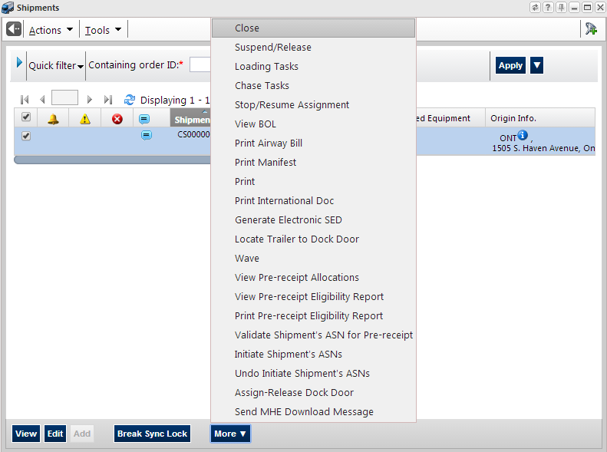
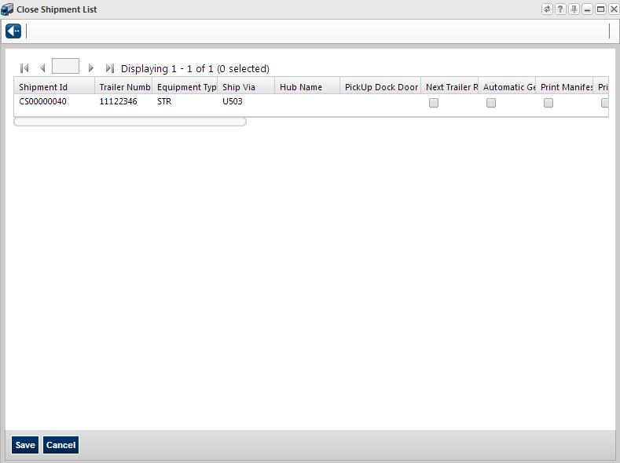
Shipments UI
User identifies Shipment to be closed. Selects Shipment and selects ‘Close’.
User captures close shipment attributes and selects ‘Save’. WM closes shipment according to user selected configuration.

Slide 162
Outbound Interfaces

Slide 163
Basic Host System Interfaces
Distribution Orders
(includes Customer Orders, Store Orders)
Host / ERP/ OMS
Item Master
Warehouse Management
ASN / PO
Inventory Transactions (PIX)
Ship Confirmation

